Slide 1


<Azy.m>
<20220523>

Slide 2

Outline
Executive Summary
Introduction
Methodology
Results
Conclusion
Appendix

Slide 3
Executive Summary
Summary of methodologies
Data Collection through API
Data Collection with Web Scraping
Data Wrangling
Exploratory Data Analysis with SQL
Exploratory Data Analysis with Data Visualization
Interactive Visual Analytics with Folium
Machine Learning Prediction
Summary of all results
Exploratory Data Analysis result
Interactive analytics in screenshots
Predictive Analytics result

Slide 4
Introduction
Project background and context
The purpose of this project was to determine if the first stage Falcon 9 will be successful using data analysis.
Falcon 9 is one of the SpaceX projects with the cost of 62 million as they advertise on their website.
Others estimate the cost as of 162 million. It just because SpaceX reuse the first stage over and over.
Therefore in this project if we determine the first stage will land then we can determine its cost.
Problems you want to find answers
Factor determines that the successful landing.
Features and variable interaction for successful landing rate.
Operation condition for successful landing.

Slide 5

Section 1

Slide 6
Methodology
Executive Summary
Data collection methodology:
The Required data was collected using API and webscrabing of SpaceX and Wikipedia
Perform data wrangling
To determine the rate of success; one-hot encoding was applied to categorical features.
Perform exploratory data analysis (EDA) using visualization and SQL
Perform interactive visual analytics using Folium and Plotly Dash
Perform predictive analysis using classification models
How to build, tune, evaluate classification models

Slide 7
Data Collection
Describe how data sets were collected.
Request.get was used to get the data from SpaceX
Normalized the data using json().normalize
Cleaned the data keeping specific features
Assigning features to dictionary and then data frame
Filtering the data and exporting to CSV
You need to present your data collection process use key phrases and flowcharts

Slide 8
Data Collection continued
Request.get was used to get the data from SpaceX
Normalized the data using json().normalize
Cleaned the data keeping specific features
Assigning features to dictionary and then data frame
Filtering the data and exporting to CSV

Slide 9
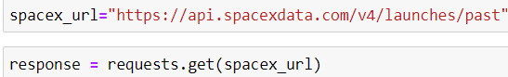
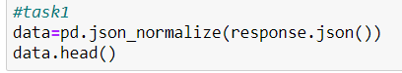
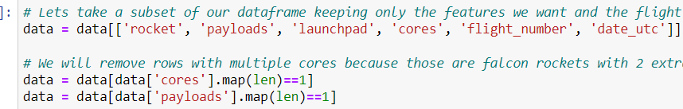
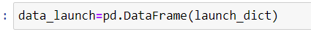
Data Collection – SpaceX API
Paths codes represents how data was collected using python method
The SpaceX API calls notebook GitHub URL is as follow: (https://github.com/azy78/DataCollectionFalcon9-20220522/blob/main/Collecting%20the%20data-Redo-20220522.ipynb), as an external reference.

Slide 10
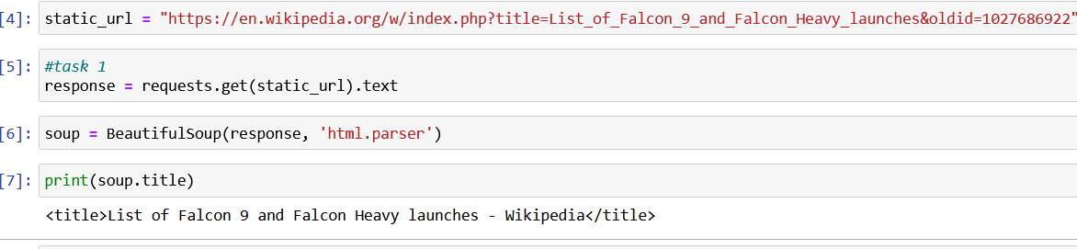
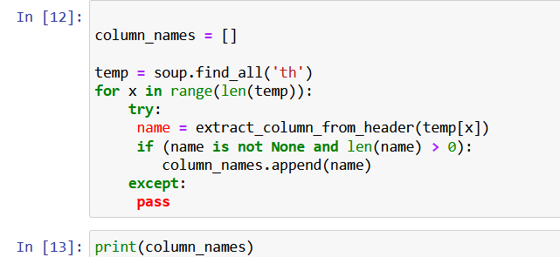
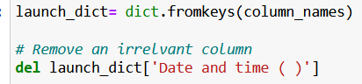
Data Collection - Scraping
The get request was used to the SpaceX API to collect data, then requested data was cleaned & formatted & was exported to CSV.
The SpaceX data collection notebook GitHub URL is as follow: (https://github.com/azy78/DataScrapping-2/blob/main/DataScrapping-20220522.ipynb), as an external reference.
Step 1:
Step2:
Step 3:
Step 4:
Step 5:

Slide 11
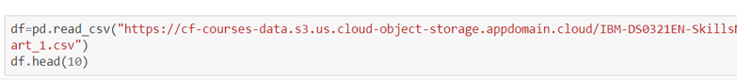
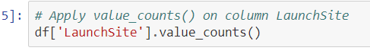
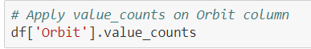
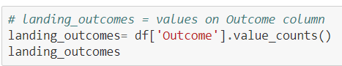
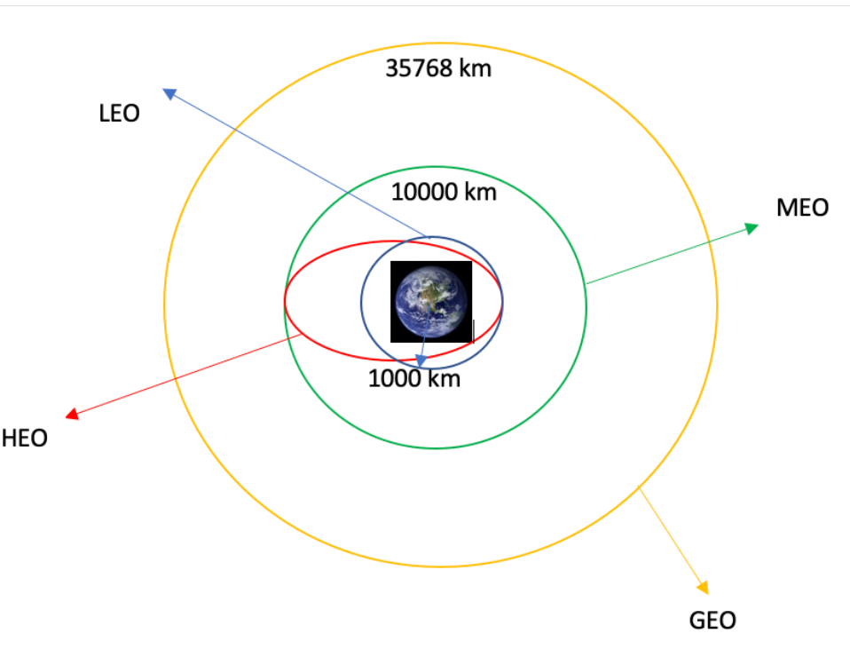
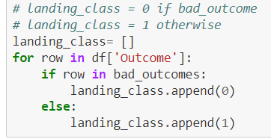
Data Wrangling
Step 1
First data was analyzed. Then number of launches on each site was calculated (each launch with dedicated orbit). Then number of occurrence on each orbit was calculated. Then the number and occurrence of mission outcome per orbit type was calculated. At the end landing outcome labels from Outcome column was calculated and the data was exported to csv.
The Data wrangling notebook GitHub URL is as follow: (https://github.com/azy78/DataWrangling20220518/blob/main/DataWrangling-20220518.ipynb) as an external reference.
Step 2
Step 3
SpaceX, orbits launch sites
Step 4
Step 5
Step 6

Slide 12
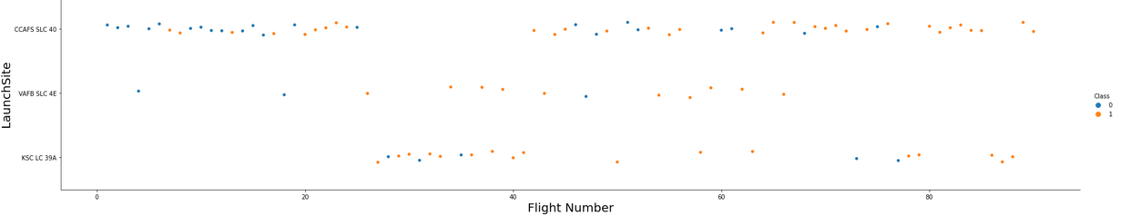
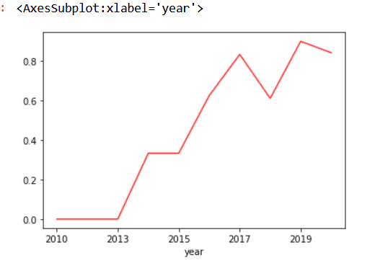
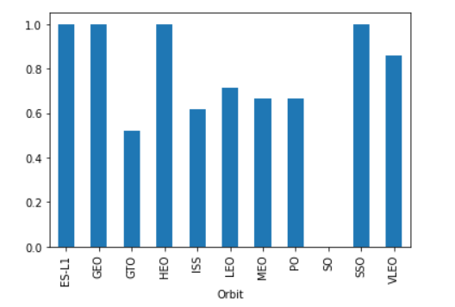
EDA with Data Visualization
Figure 1
The relationship between Flight Number and Launch Site was visualized
(figure 1).
The relationship between success rate of each orbit type was visualized
using bar graph (figure 2).
Visualize the launch success yearly trend (figure 3)
Figure 3
The EDA notebook GitHub URL
is as follow: (https://github.com
/azy78/EDA-Data-vitulization-202205022-3/blob/main/EDA%20with%20Data%20Visualization-20220522.ipynb) as an external reference.
Figure 2

Slide 13
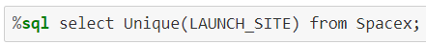
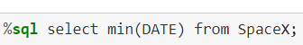
EDA with SQL
The name of unique launch sites in the space mission:
Records where launch sites found using string ‘CCA:
The total payload mass carried by boosters launched by NASA (CRS) was found:
The average payload mass carried by booster was found:
The date of the first successful landing was found using min function:
Names of the boosters with success in drone ship & with payload mass 4000> & < 6000:
Total number of success and failure landing was found:
The EDA with SQL notebook GitHub URL
is as follow: (https://github.com/azy78/EDA-with-SQL-20220522Lab/blob/main/lab2-20220518.ipynb) as an external reference.

Slide 14
Build an Interactive Map with Folium
All the launching site on map was marked with blue circles, using Folium. Circle and Folium.Marker.
The success/failed launches for each site on the map was marked using Marker Cluster object.
The distances between a launch site to its proximities was calculated by adding Mouse Position & using a Marker object & by drawing a polyline.
The Build an Interactive Map with Folium notebook GitHub URL is as follow: (https://github.com/azy78/Build-an-Interactive-Map-with-Folium/blob/main/Launch%20Sites%20Locations%20Analysis%20with%20Folium-Lab20220521.ipynb) as an external reference.

Slide 15
Build a Dashboard with Plotly Dash
An interactive dashboard with Plotly dash was made.
Pie charts showing the total launches by a certain sites was built.
A scatter graph showing the relationship with Outcome and Payload Mass (Kg) for the different booster version was plotted.
The Dash with Plotly notebook GitHub URL is as follow: (https://github.com/azy78/Spacex-Dash/blob/main/spacex_dash_app.py)

Slide 16
Predictive Analysis (Classification)
Data was loaded into data sets and was virtualized and was early analyzed.
The data set was split into training set and test set & picked ML algorithm ( Building the model).
Models accuracy was determined and confusion matrix was made (Model evaluation).
The models was improved by tuning the algorithm and variables (Model improvement).
The GitHub URL of the completed predictive analysis lab is as follow:
(https://github.com/azy78/MachinLearning-20220519/blob/main/Machine%20Learning%20PredictionRedo-lab20220521(1).ipynb)

Slide 17
Results
Exploratory data analysis results
Interactive analytics demo in screenshots
Predictive analysis results

Slide 18

Section 2

Slide 19

Flight Number vs. Launch Site
The scattered plot shows the launch site vs flight number of Falcon 9 SpaceX , the class 0 (blue dots) shows the fail launch and class 1(orange dots) shows successful launches. The site CCAFS SLC 40 has the largest amount of launching.

Slide 20
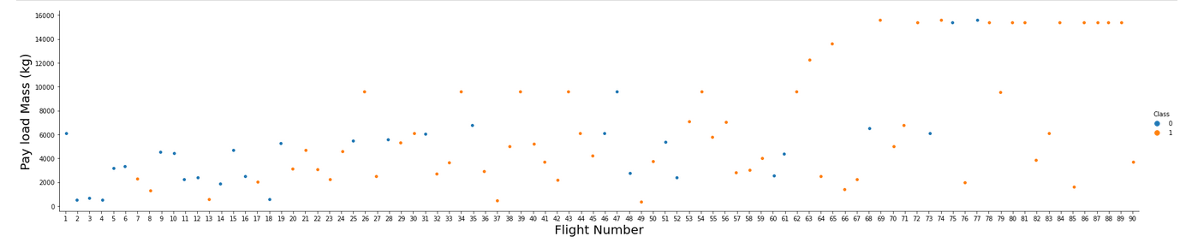
Payload vs. Launch Site
The scattered plot shows the relation between the Pay load Mass (Kg) to flight number. It shows the higher the mass the higher the rate of failing.

Slide 21
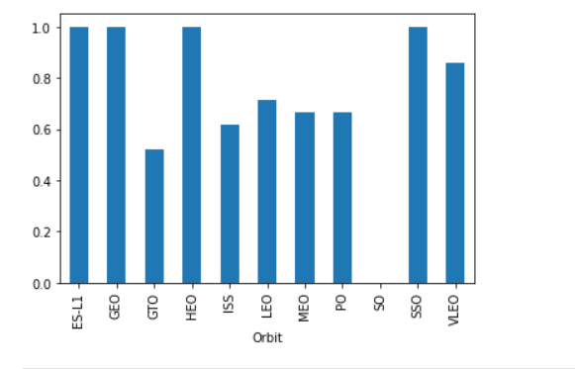
Success Rate vs. Orbit Type
The bar chart shows the success rate of each orbit type.
ES-L1, GEO, HEO and SSO have the most successful rate out of all orbits.

Slide 22
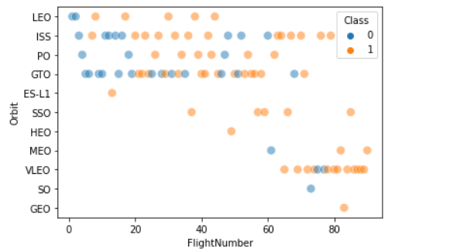
Flight Number vs. Orbit Type
The plot below shows the Flight Number vs. Orbit type.
The graph shows that more flights was done
In orbits GTO, PO, ISS, LEO, either successful or failed.

Slide 23
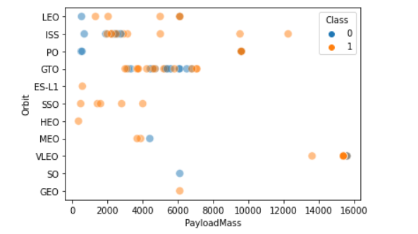
Payload vs. Orbit Type
The plot shows the correlation between the orbit and payloadmass.
The lower the mass and the smaller the orbit has more flights around them.
GTO and ISS orbits have more consistent trails.

Slide 24
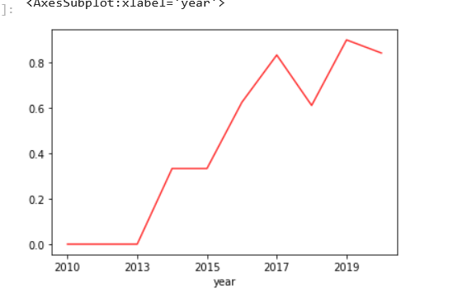
Launch Success Yearly Trend
The plot shows the yearly average success rate of Falcon 9.
The graph shows over years with improvement & tunning the conditions, it has more success rates.

Slide 25
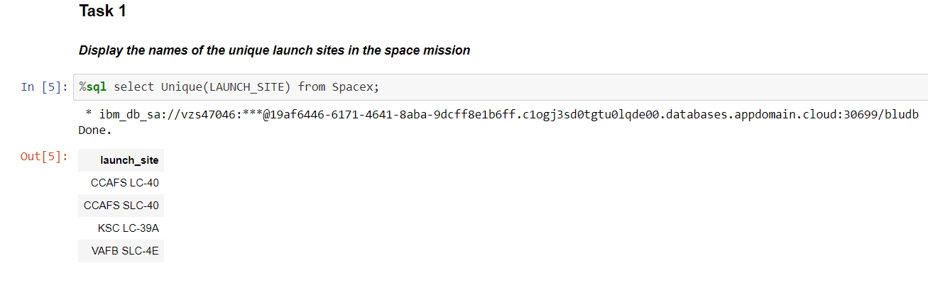
All Launch Site Names
Four names of unique launch sites in the spaceX mission was found using % sql select method from EDA SQL lab.

Slide 26
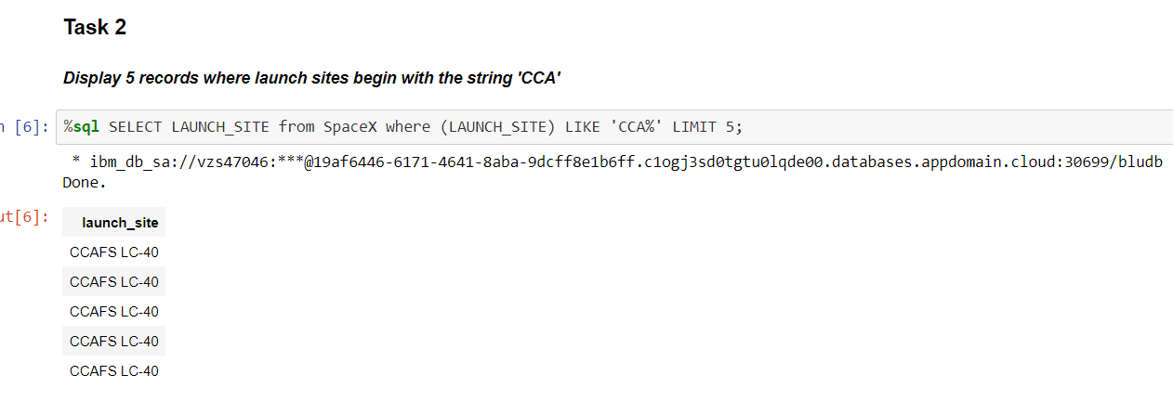
Launch Site Names Begin with 'CCA'
The screen shot above shows 5 records where launch sites begin with the string CCA. This was found using % sql select method.

Slide 27
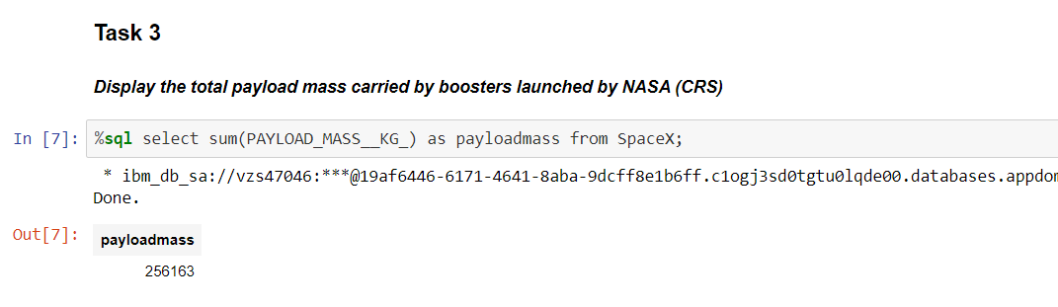
Total Payload Mass
The screen shot above shows the total payload carried by boosters from NASA. The total payload mass was 256,163 kg. This was found using %sql select method.

Slide 28
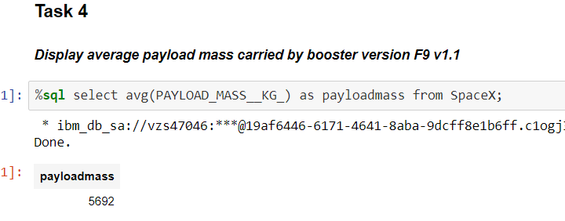
Average Payload Mass by F9 v1.1
The screen shot shows the calculation of the average payload mass carried by booster version F9 v1.1. The average mass was 5692 kg. This was found using % sql select method.

Slide 29
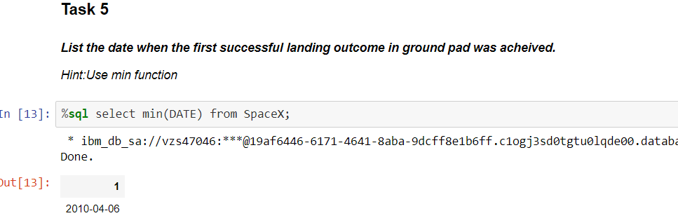
First Successful Ground Landing Date
The screen shots shows the date of the first successful landing outcome on ground pad. This was found using min function and %sql select method.

Slide 30
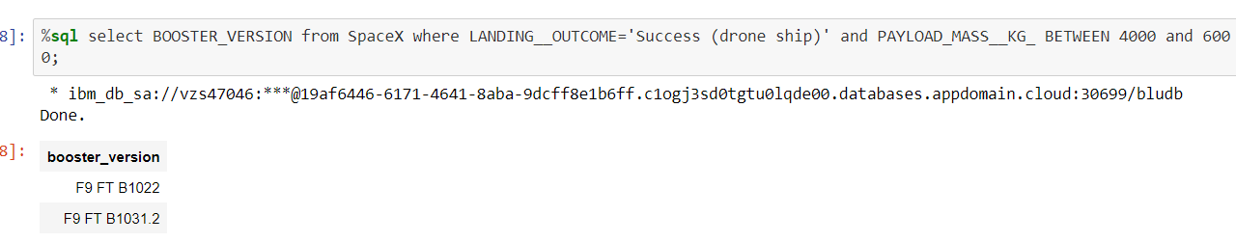
Successful Drone Ship Landing with Payload between 4000 and 6000
The screen shots shows the names of boosters which have successfully landed on drone ship and had payload mass greater than 4000 but less than 6000. Thus was found using % sql select booster_version method.

Slide 31
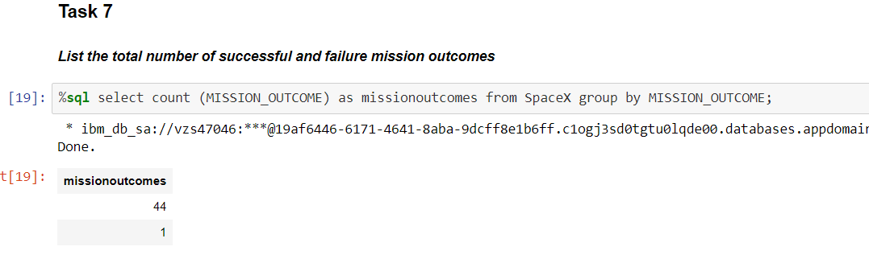
Total Number of Successful and Failure Mission Outcomes
The screen shot shows the total number of successful and failure mission outcomes.
The outcome shows 44 attempt successful and 1 fail trial.

Slide 32
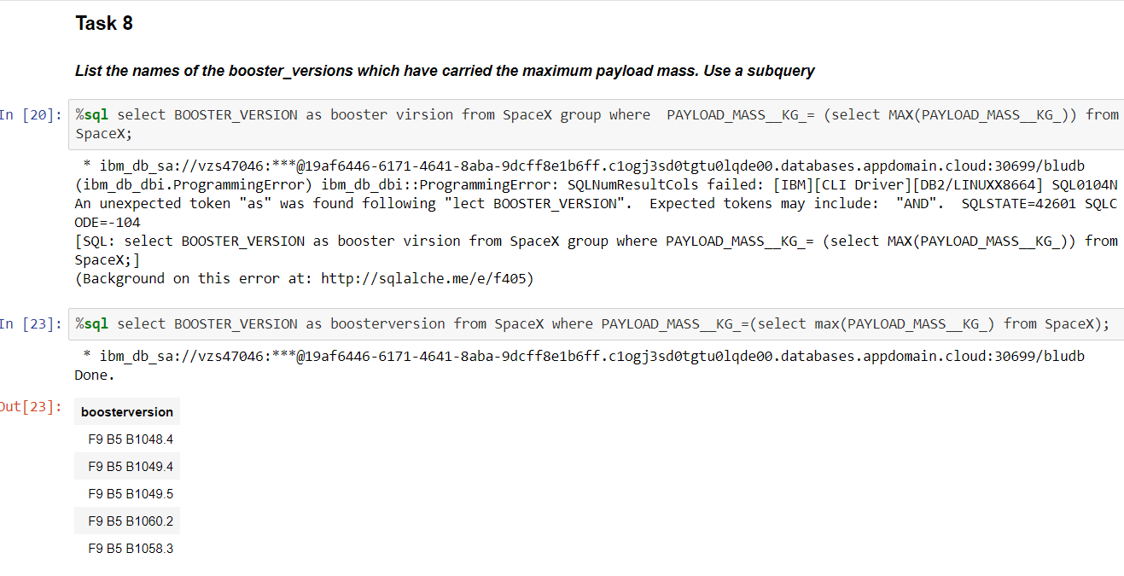
Boosters Carried Maximum Payload
The screen shot shows names of the booster which have carried the maximum payload mass
The results was found using %sql select booster_version.

Slide 33
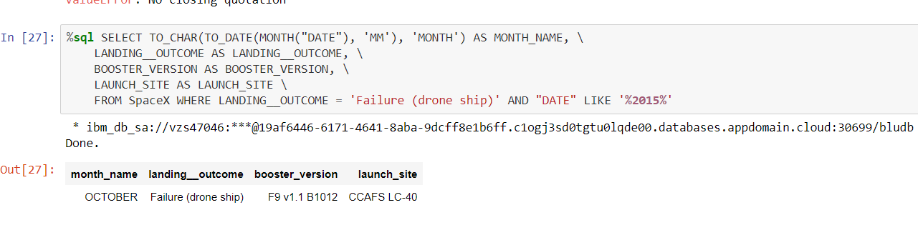
2015 Launch Records
The screen shot shows failed landing_outcomes in drone ship, their booster versions, and launch site names for in year 2015.
The result was found using % sql select method.

Slide 34
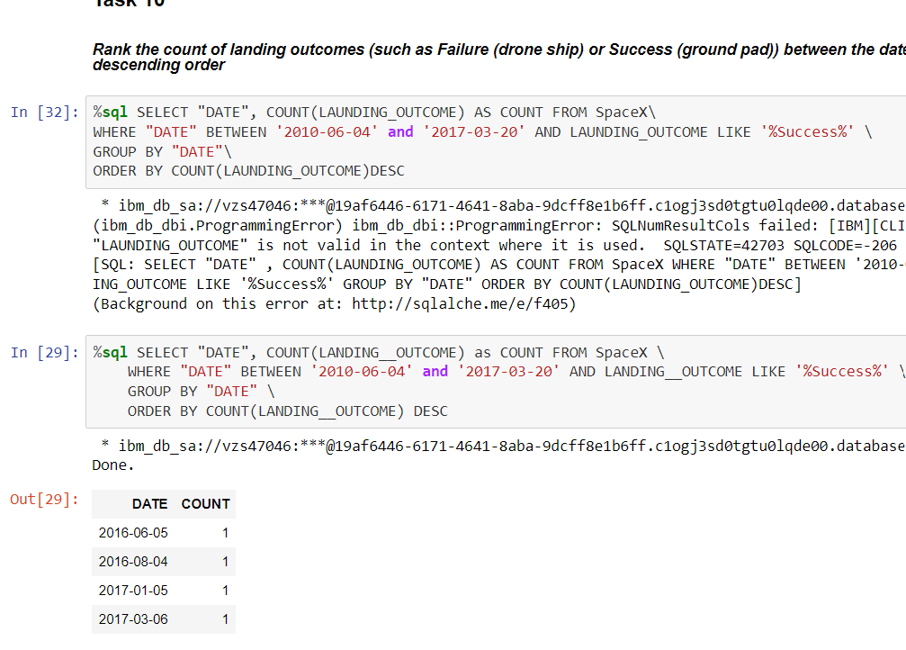
Rank Landing Outcomes Between 2010-06-04 and 2017-03-20
The screen shot shows rank the count of landing outcomes (such as Failure (drone ship) or Success (ground pad)) between the date 2010-06-04 and 2017-03-20, in descending order.
It was found using %sql select method.

Slide 35

Section 3

Slide 36
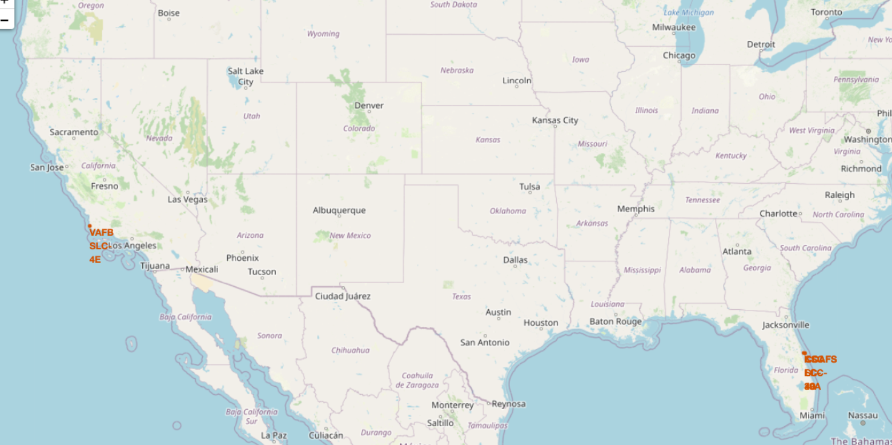
All launch sites global map markers

Slide 37
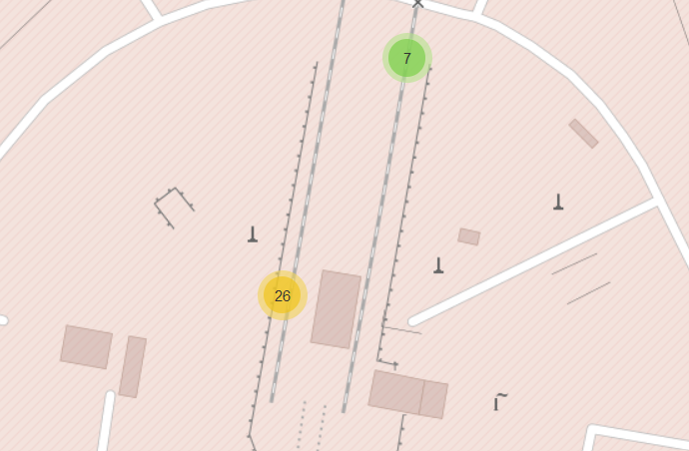
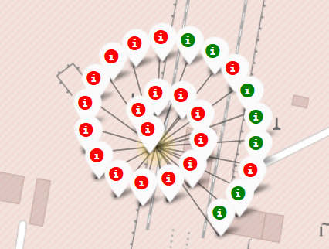
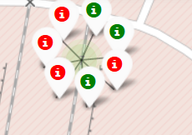
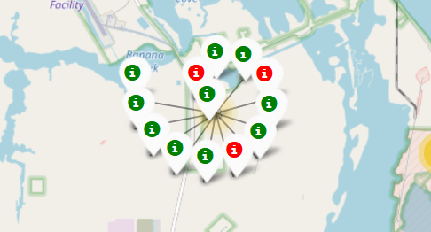
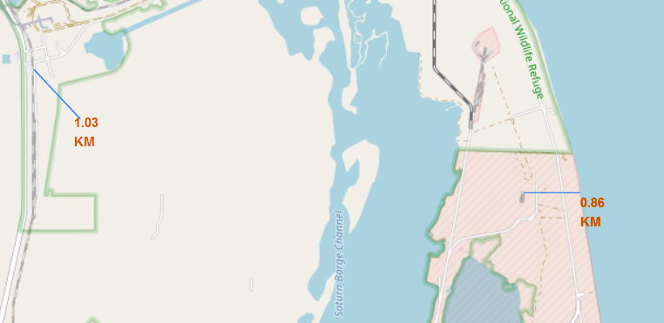
Markers showing launch sites with color labels
Using mouse position two sites were explored.
The green color shows the successful landing and the red color shows the fail landing.

Slide 38
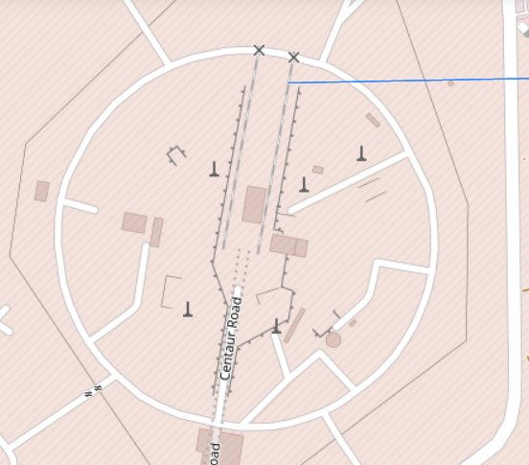
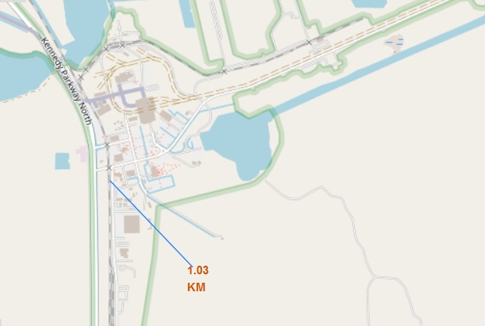
Launch Site distance to landmarks
The screen shot shows
The distance of the roads and the railways to the site.

Slide 39

Section 4

Slide 40

Pie chart showing the success percentage achieved by each launch site

Slide 41

Pie chart showing the Launch site with the highest launch success ratio

Slide 42

Scatter plot of Payload vs Launch Outcome for all sites, with different payload selected in the range slider.

Slide 43

Section 5

Slide 44
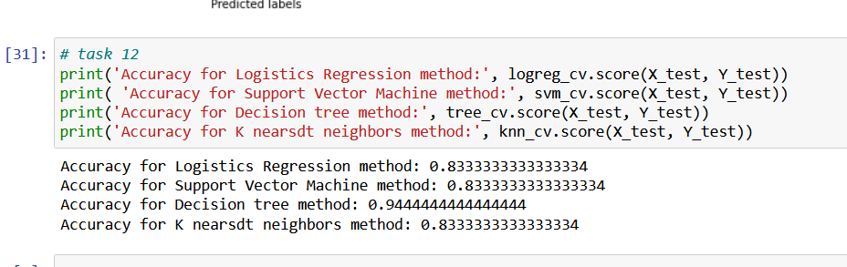
Classification Accuracy
As the printed accuracy of the four models shows the decision tree has the highest accuracy.

Slide 45
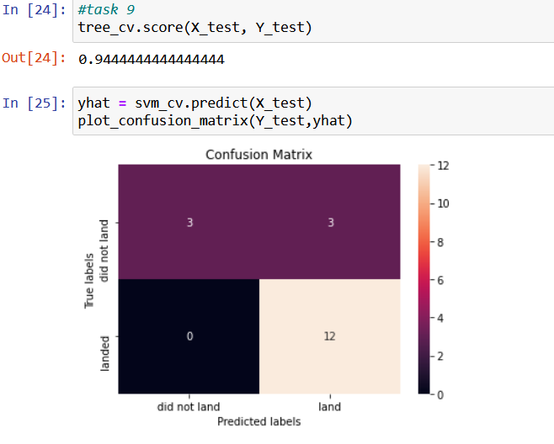
Confusion Matrix
The screen shot shows the confusion
matrix of decision tree model. The accuracy
Is over %90. The major problem is the false
Positives. The unsuccessful landing
marked as successful landing
by the classifier.

Slide 46
Conclusions
The Decision tree classifier is the best machine learning algorithm.
The higher the flight numbers at a launch site, the greater the success rate.
Launch success rate improved from in 2010 till 2019.
Orbits ES-L1, GEO, HEO, SSO, VLEO had the most success rate.
The lower the mass load the better was the performance.

Slide 47


